Slide 1
HCL Electronic Shop
Class Name: PF1124
Group Name: HCL
Instructor: Nguyen Dinh Cuong
Member: Nguyen Hai Long
Pham Nam Cuong
Pham Ngoc Huy

Slide 2

Objectives
This application project was created to help with managing digital marketing business models, it helps to improve management efficiency. Staffs and customers have easy access to products information, which include price, name, product details or even it’s status, they can also easily place in any order with the shopping cart function. The main function of this system is for management, it helps the business with managing their products, orders as well as customers or even employees. Staffs can also create new user account for their customers or place in any order according to the customer’s request, allow them to view the information of unpaid orders and confirm successful payment if enough money has been received from the customers as well as canceling the order if necessary.

Slide 3

Introduction to Project
The application system will provide these following features:
Register/Login system:
  Multiple user cases (Customer, Admin, Super Admin which each will have their own option menu)
General products & functions:
  View Product/Category information lists function
  Search for Product/Category functions
Shopping cart & placing order function:
  Adding & removing Products to or from Shopping Cart to place Order
  View Shopping Cart functions for all roles/user cases.
  Complete & place order, cancelling order for all user cases.
  Picking payment methods & checking out.
  Checking Order details & status function for every user cases.
Management functions:
  Adding/removing/editing Product functions for Admin & Super Admin.
  Adding/removing/editing Category functions for Admin & Super Admin.
  Adding/removing/editing Customer functions for Admin & Super Admin.
  Adding/removing/editing Admin functions for Super Admin.

Slide 4


Customer Requirements
You must login to use the system.
You must have your account role set to be Admin or Super Admin to use their menu functions.
You must have your address, phone number and payment method information to place an order.
You must contact Admins or Super Admins in order to change your Customer information details.

Slide 5
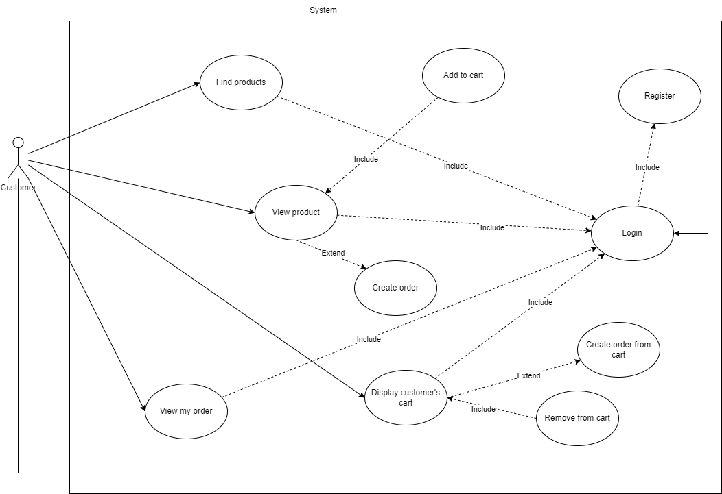
Use Case
When customer log into the system, the application will display the program's customer menu with the following options:
View product with built-in functions:
  Purchase product.
  Add product to cart.
Find product.
View category (which you can also view all the list of products that belongs to this category).
Find category.
View shopping cart with built-in functions:
  Remove product from shopping cart.
  Place an order for all the products in shopping cart.
View order information.

Slide 6
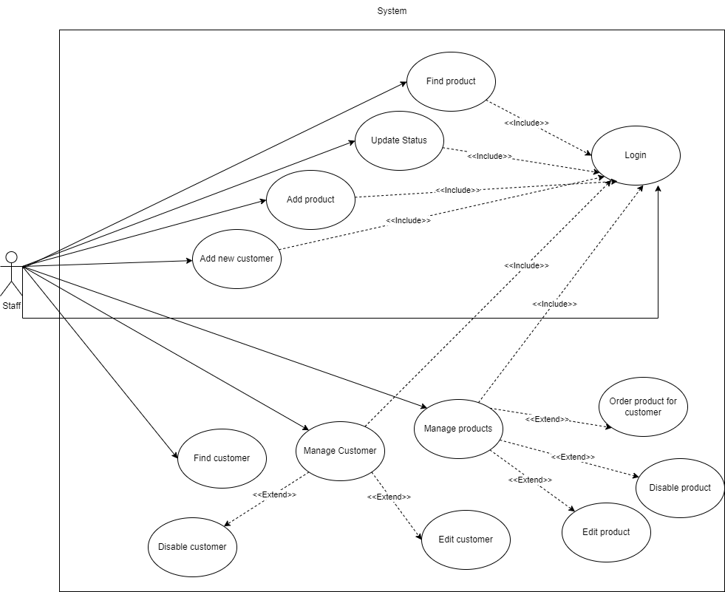
Use Case
When staff log into the system, the application will display the program's Admin menu with the following options:
Add new product
Manage product with the following built-in functions:
  Edit product
  Delete product
  Place order for customer
Manage product import
Manage product export
Customer management with the following functions:
  Register new account for customer
  Edit customer information
  Delete customer
Every other options that’s available for customers

Slide 7
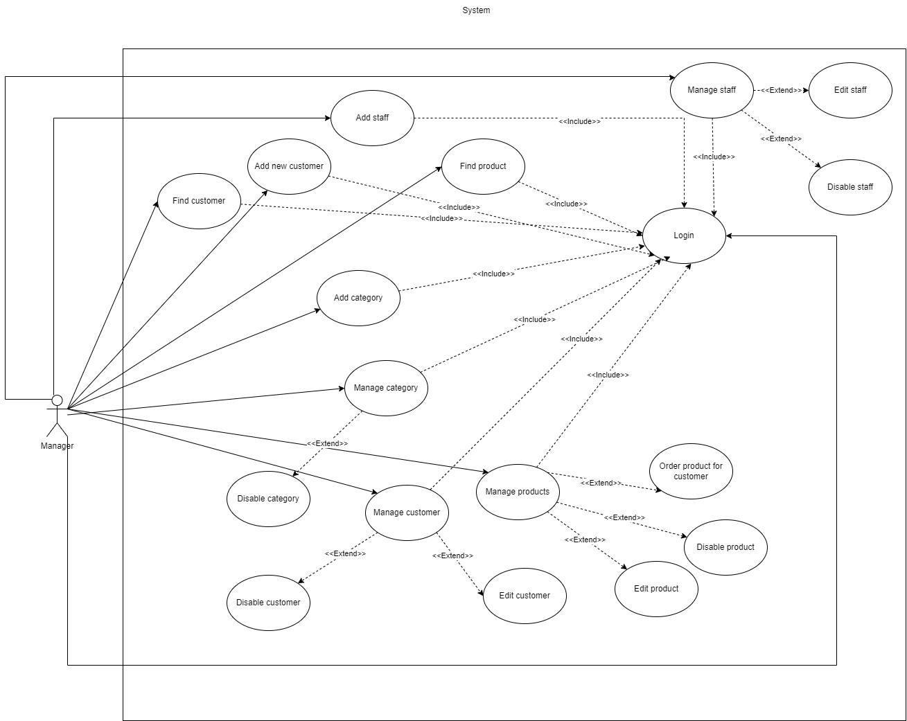
Use Case
When manager log into the system, the application will display the program’s Super Admin menu with the following options:
Staff management with the following functions:
  Add new staff/admin account
  Edit staff information
  Display list of staffs
  Delete staff
Category management with the following functions:
  Add new category
  Delete category
  Edit category
Every other options available for admin and customer menu

Slide 8
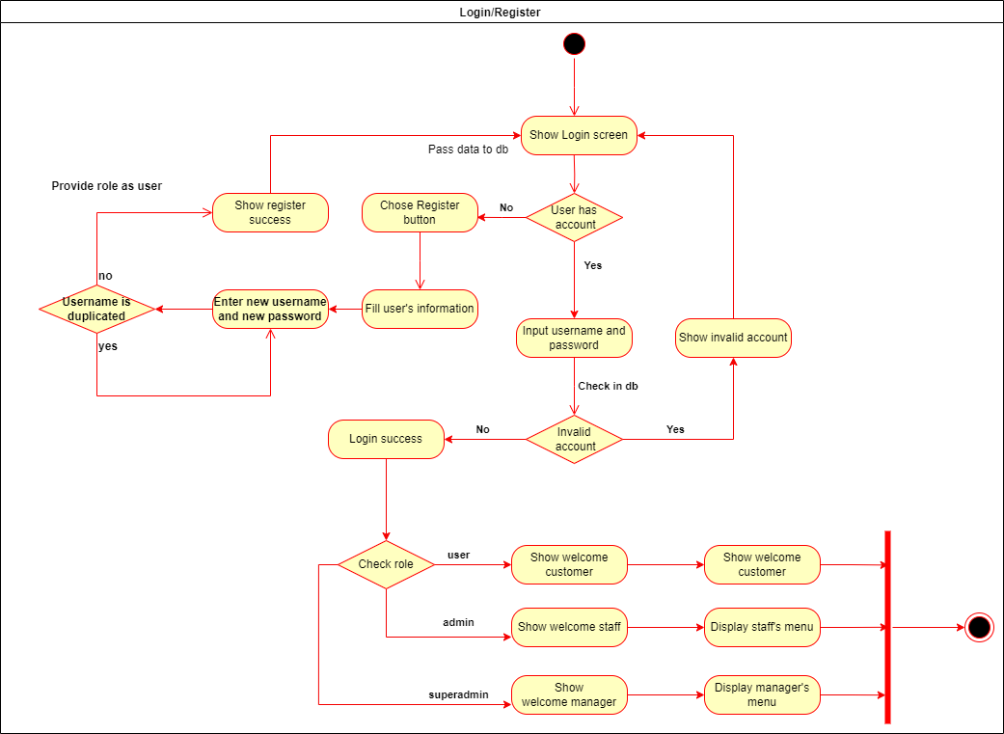
Activity Diagram

Slide 9
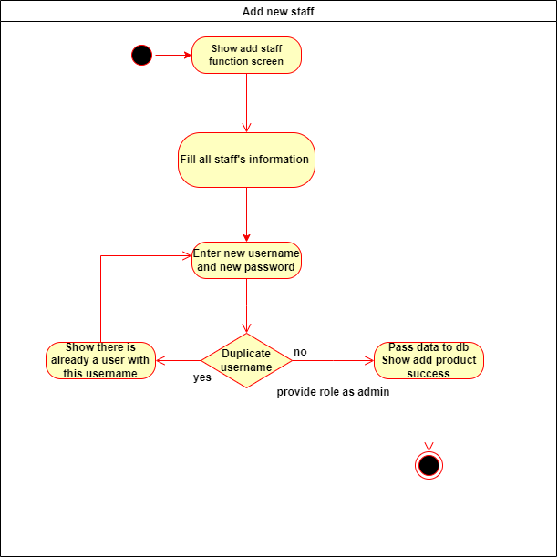
Activity Diagram

Slide 10
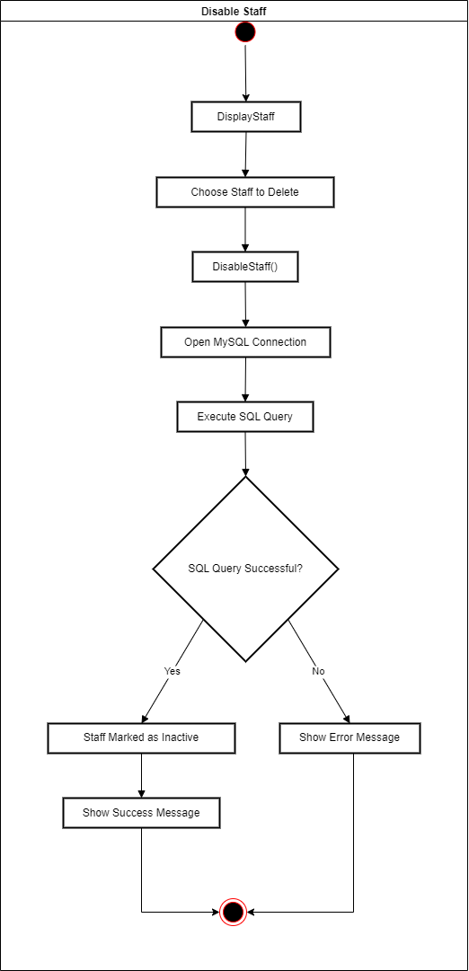
Activity Diagram

Slide 11
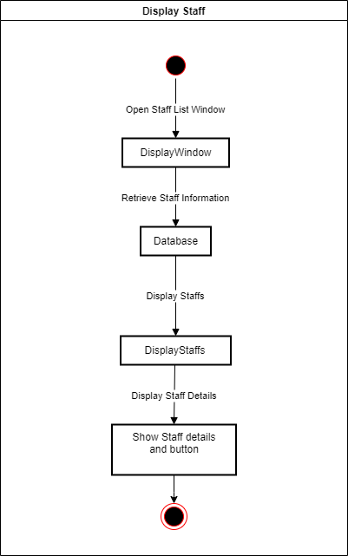
Activity Diagram

Slide 12
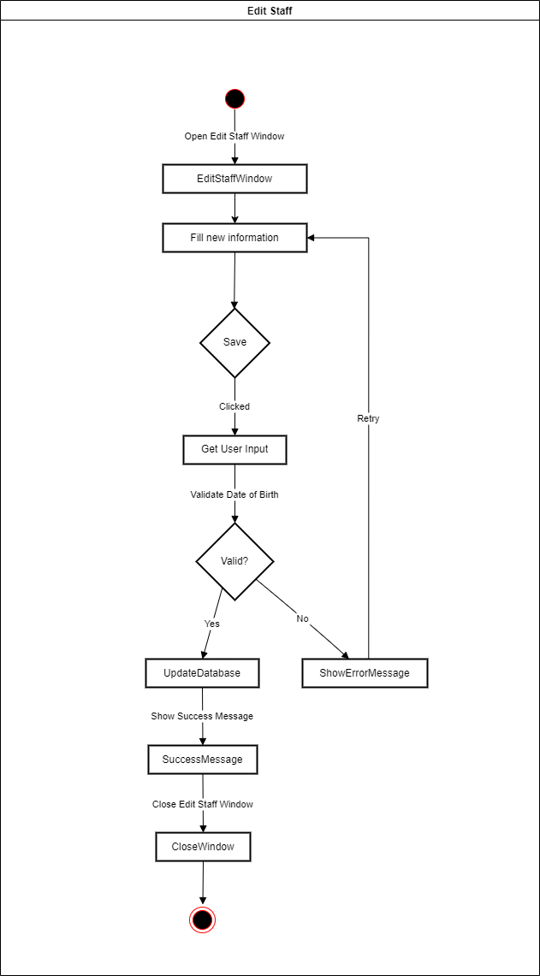

Activity Diagram

Slide 13
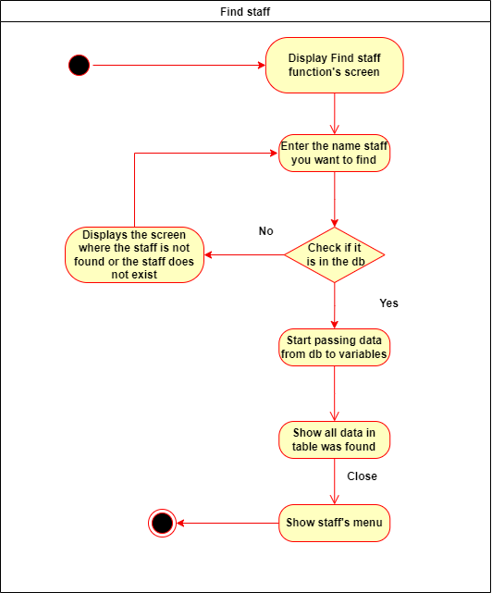

Activity Diagram

Slide 14

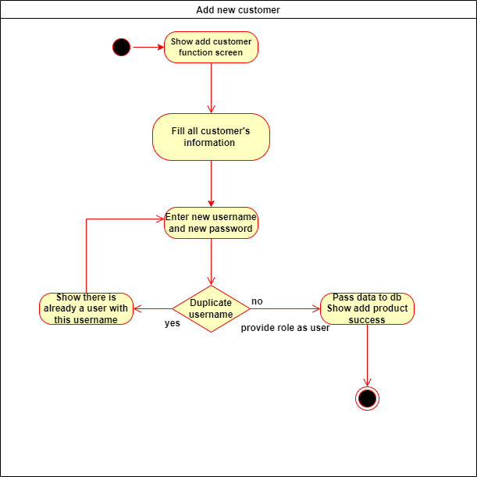
Activity Diagram

Slide 15
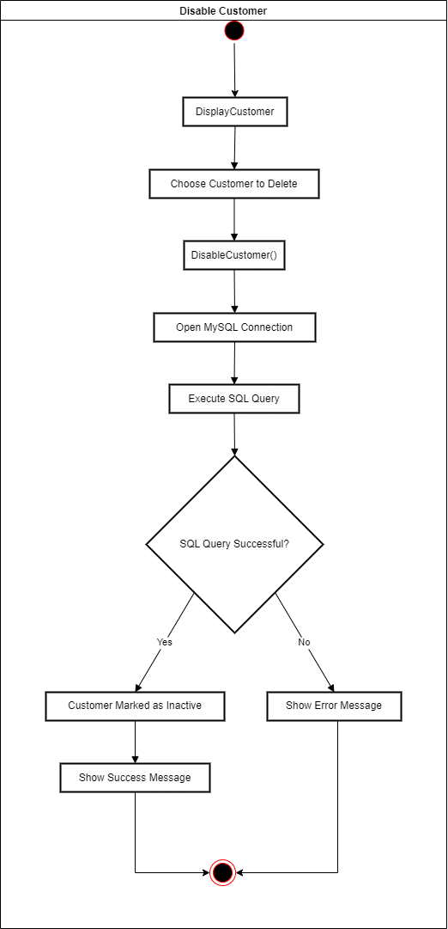

Activity Diagram

Slide 16
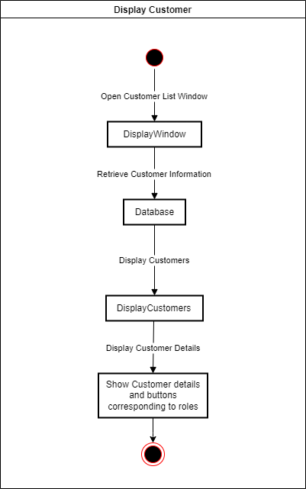
Activity Diagram

Slide 17

Activity Diagram

Slide 18
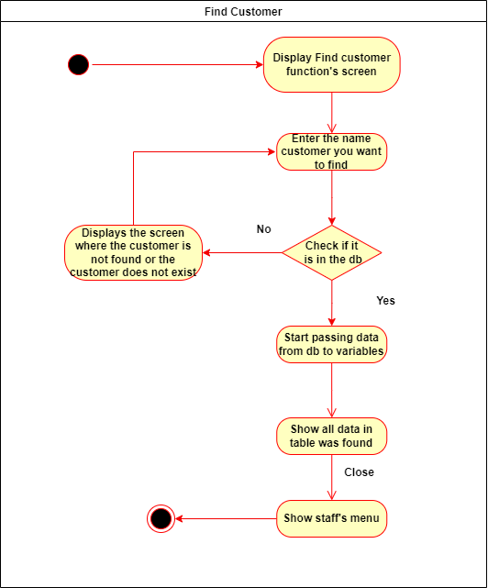
Activity Diagram

Slide 19
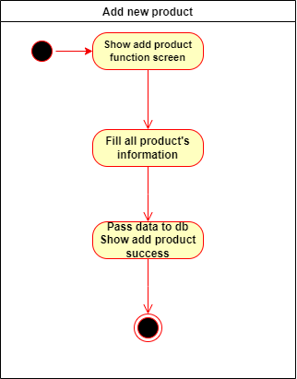
Activity Diagram

Slide 20

Activity Diagram

Slide 21
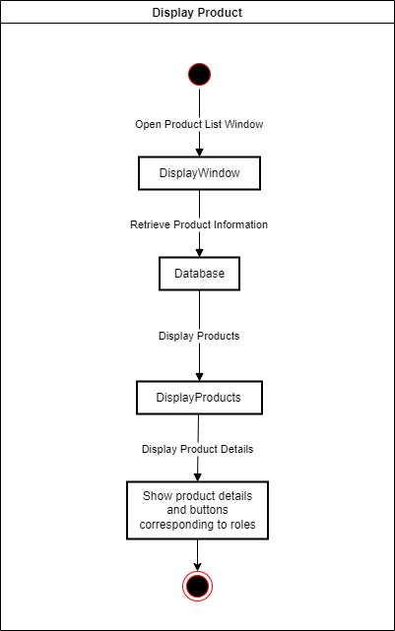
Activity Diagram

Slide 22
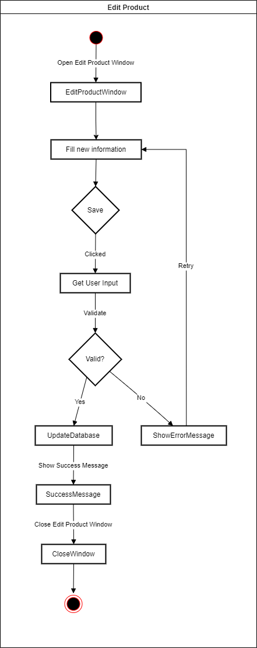
Activity Diagram

Slide 23
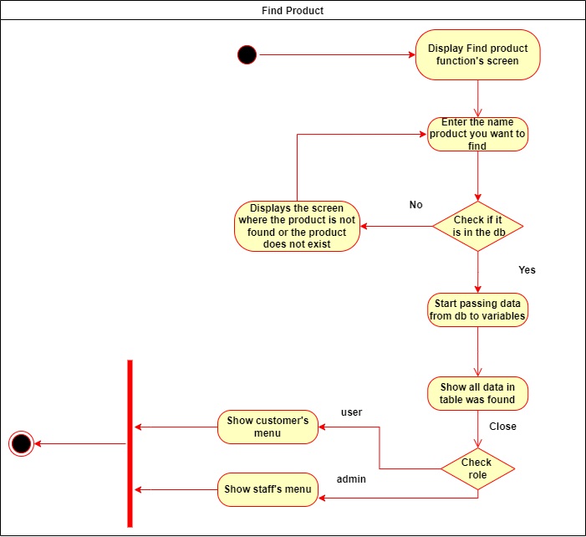
Activity Diagram

Slide 24
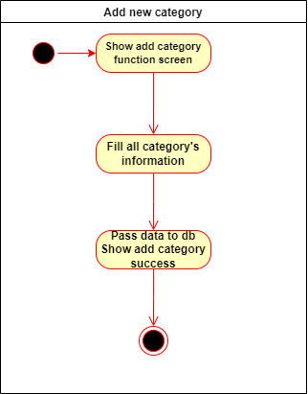
Activity Diagram

Slide 25

Activity Diagram

Slide 26
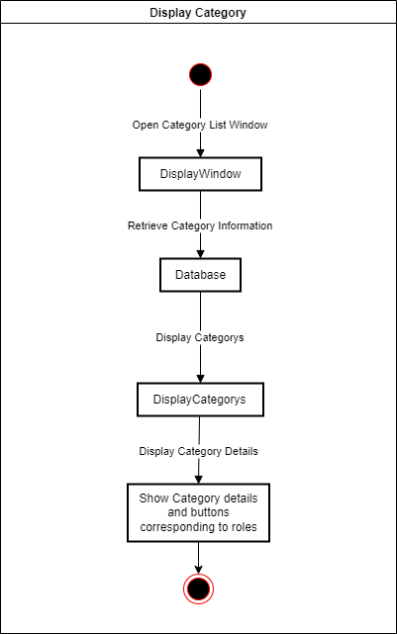
Activity Diagram

Slide 27

Activity Diagram

Slide 28
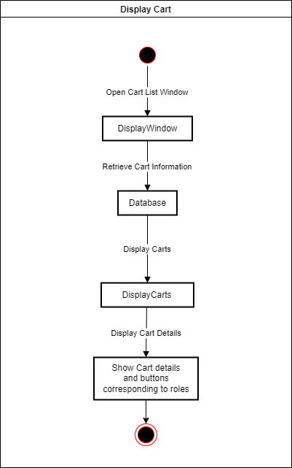
Activity Diagram

Slide 29
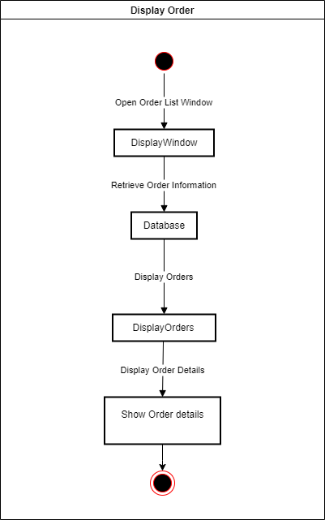
Activity Diagram

Slide 30
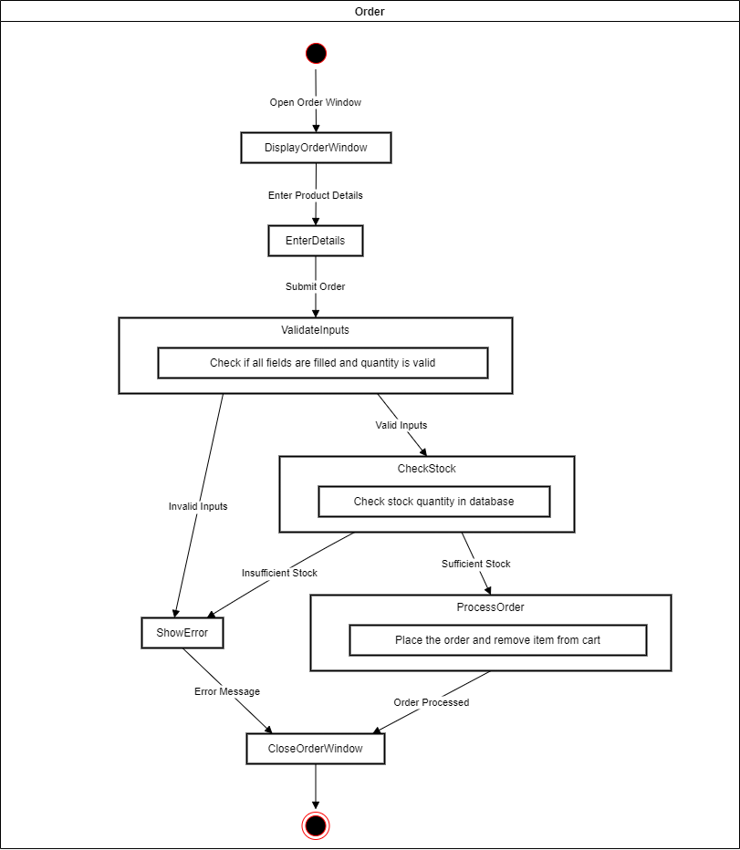
Activity Diagram

Slide 31
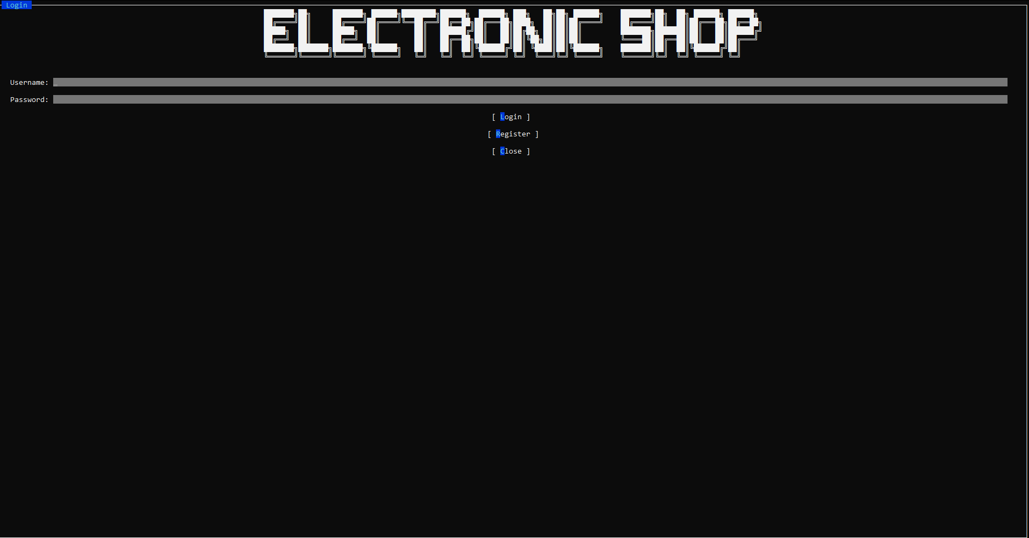
UI Design

Slide 32
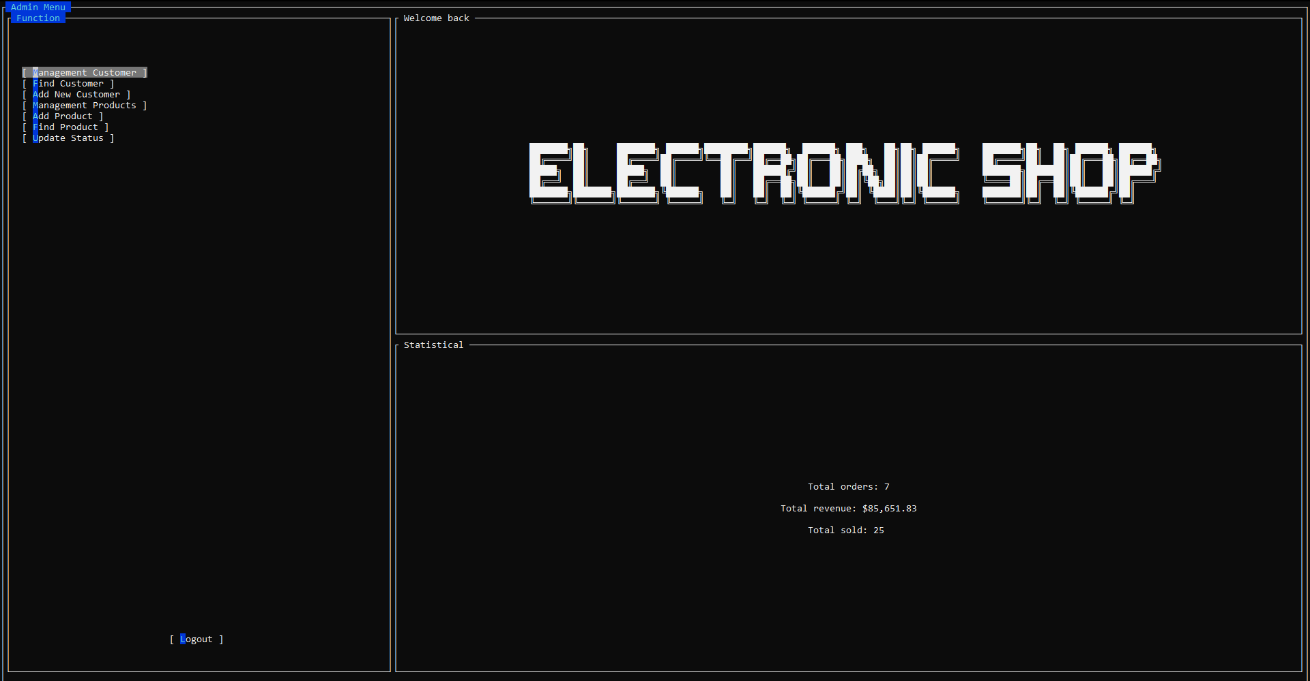
UI Design

Slide 33
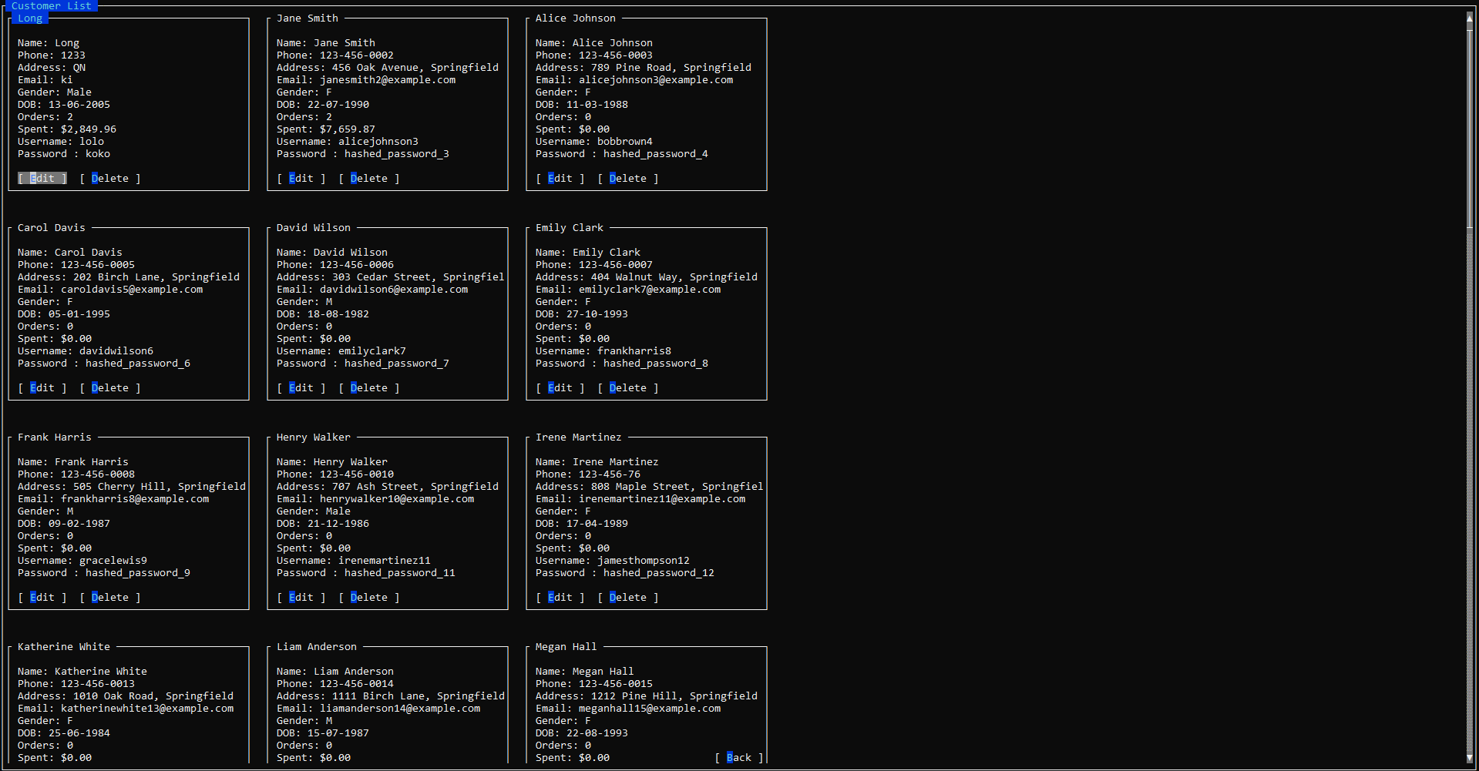
UI Design

Slide 34
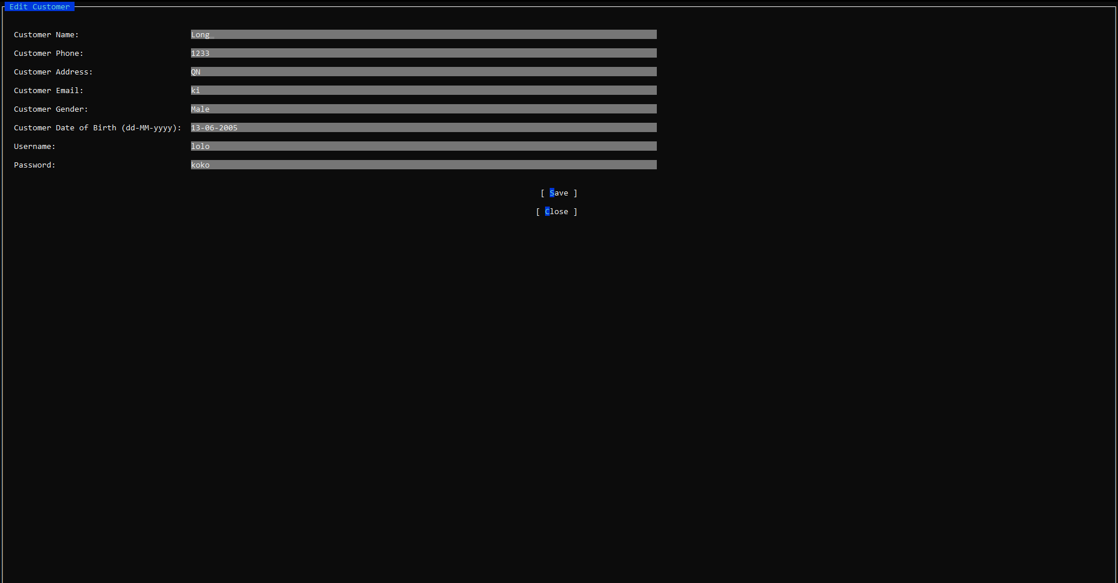
UI Design

Slide 35
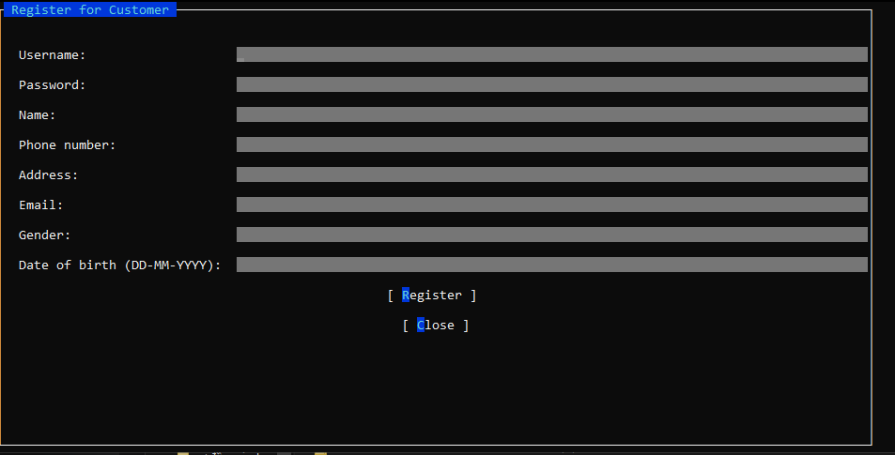
UI Design

Slide 36
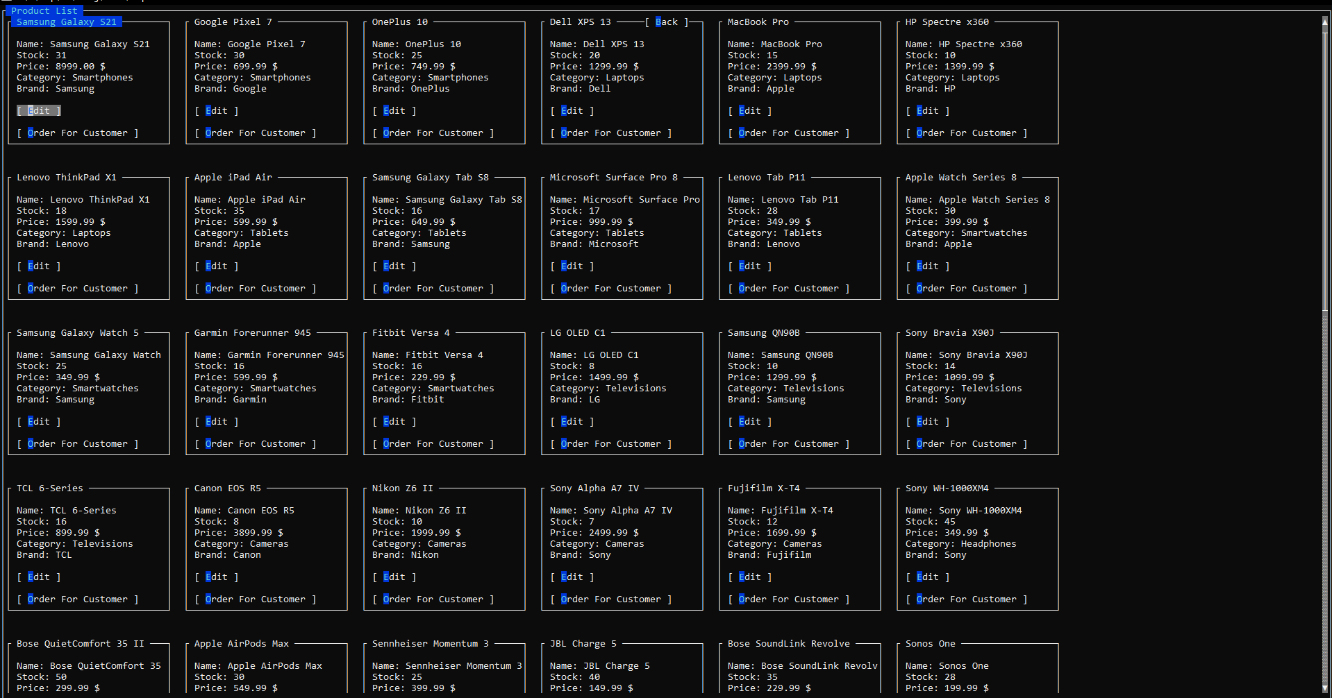
UI Design

Slide 37
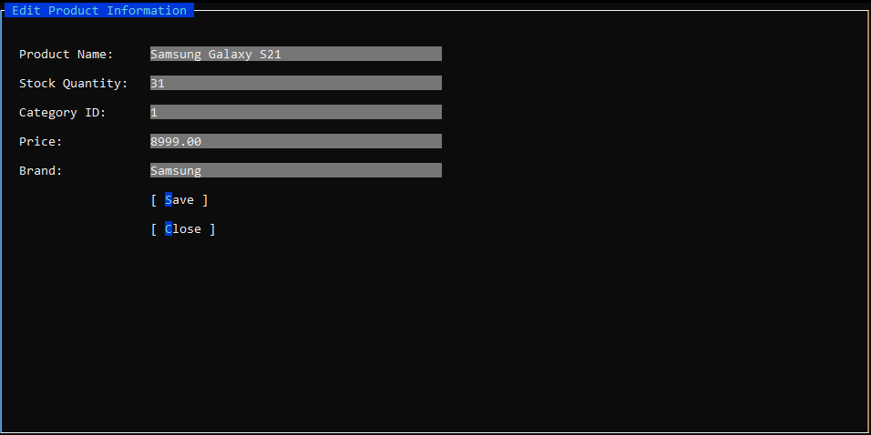
UI Design

Slide 38
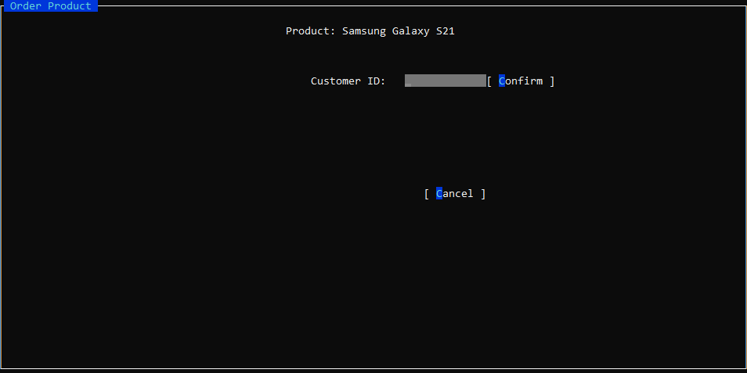
UI Design

Slide 39
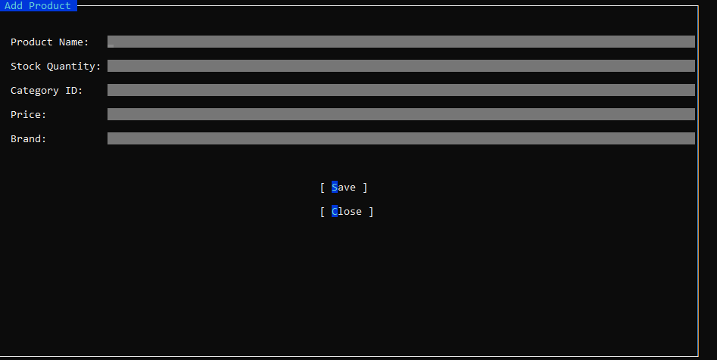
UI Design

Slide 40
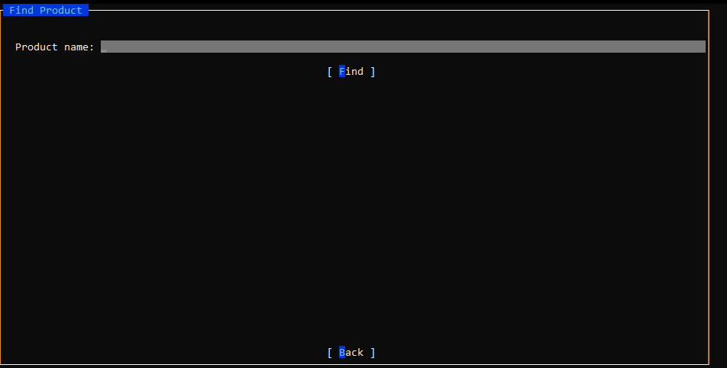
UI Design

Slide 41
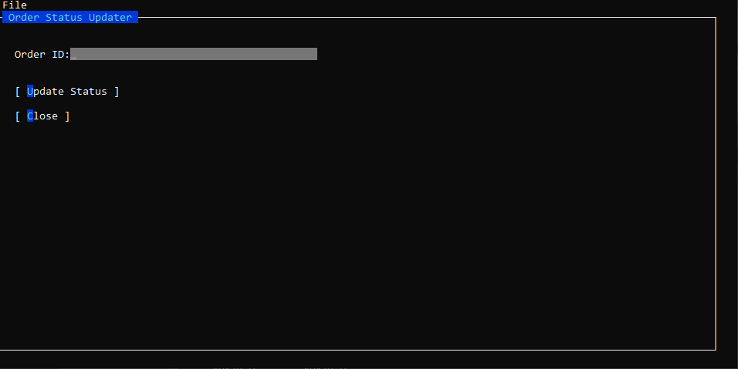
UI Design

Slide 42
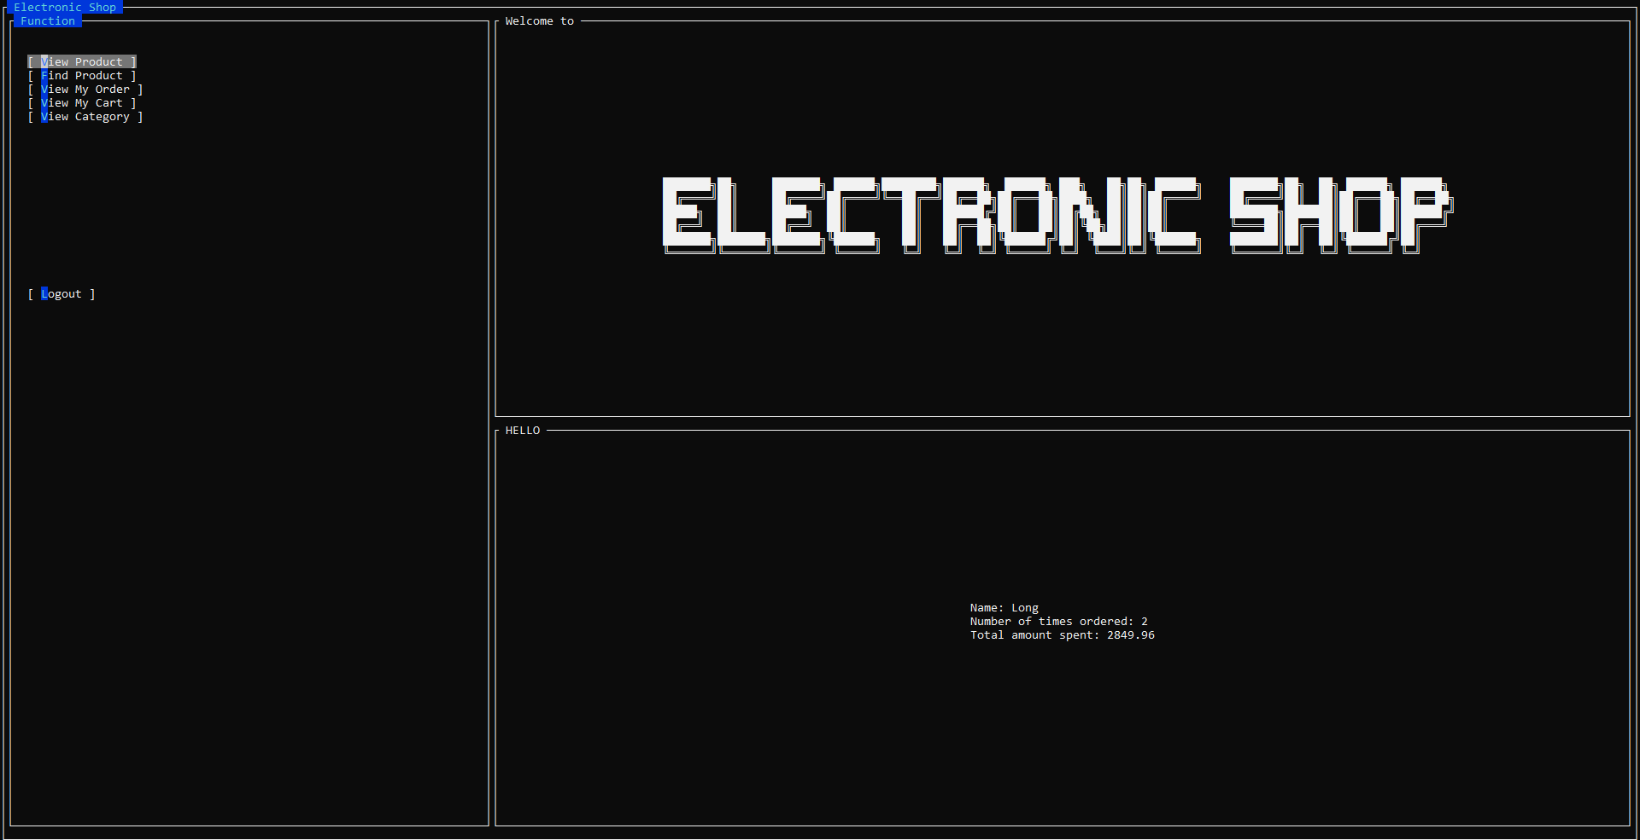
UI Design

Slide 43
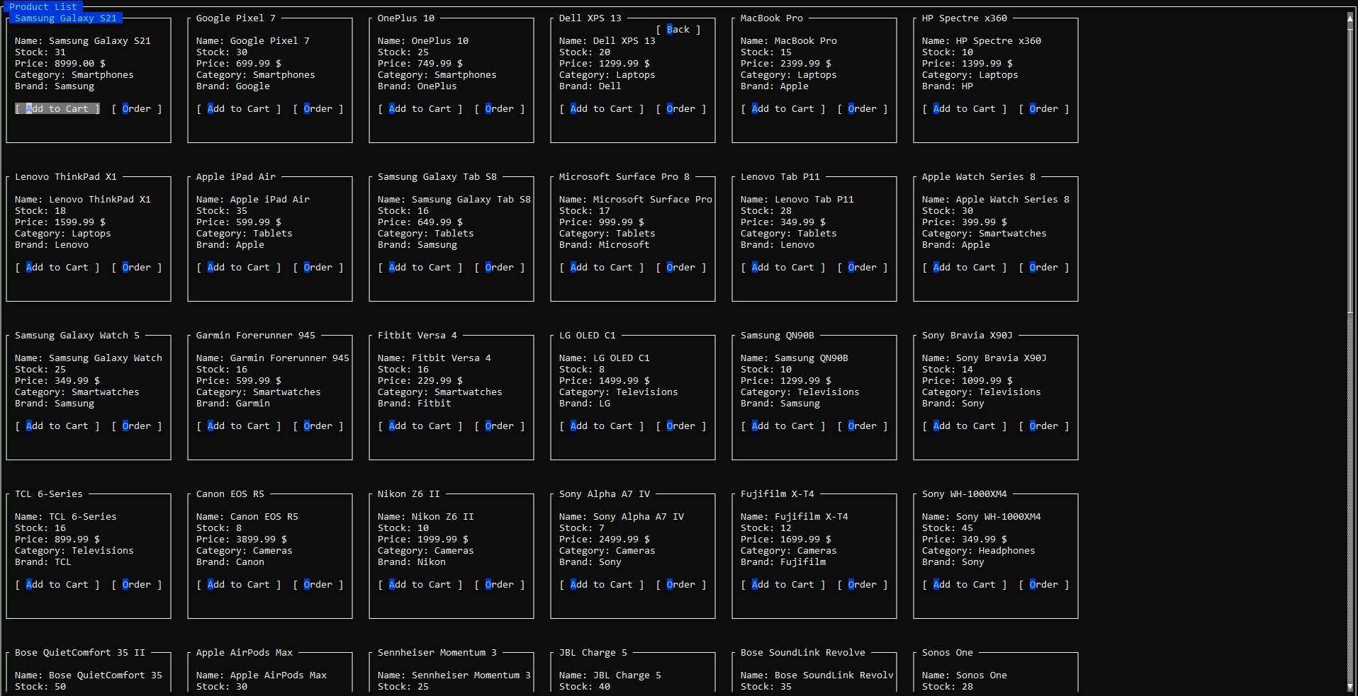
UI Design

Slide 44
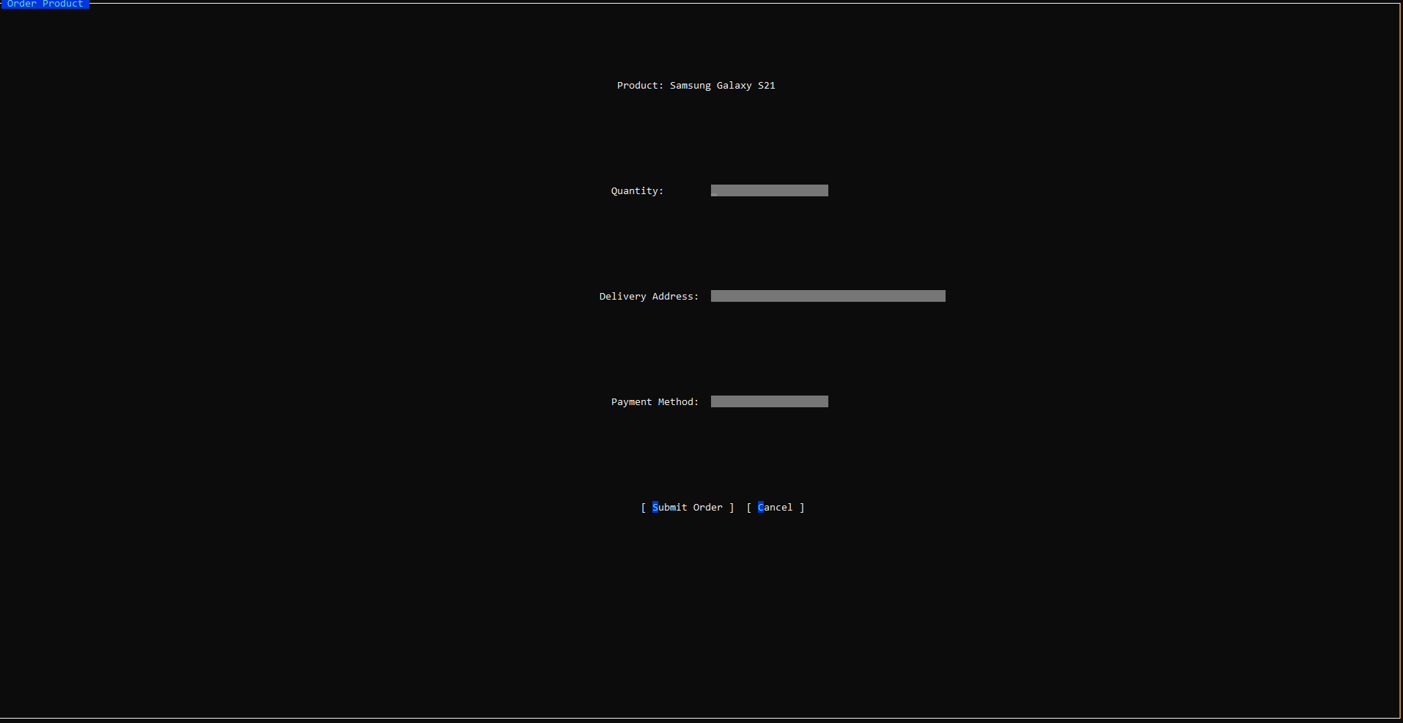
UI Design

Slide 45
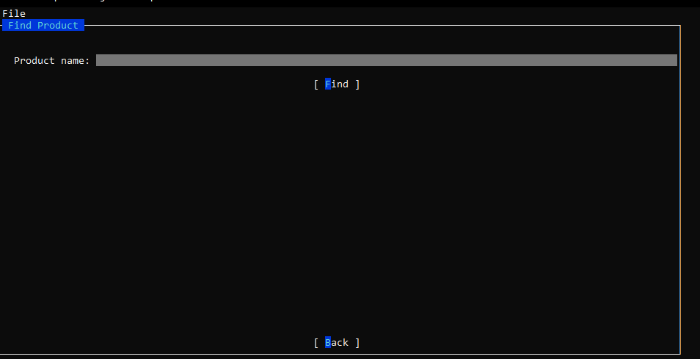
UI Design

Slide 46
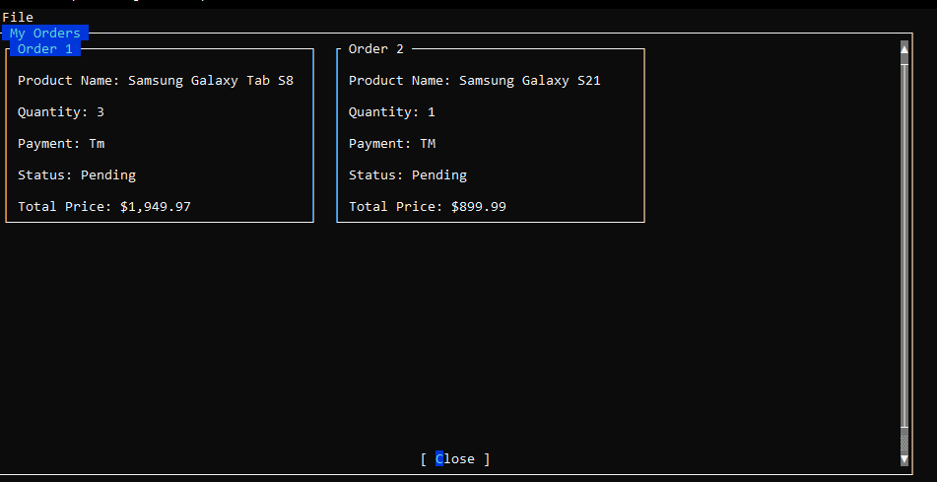
UI Design

Slide 47
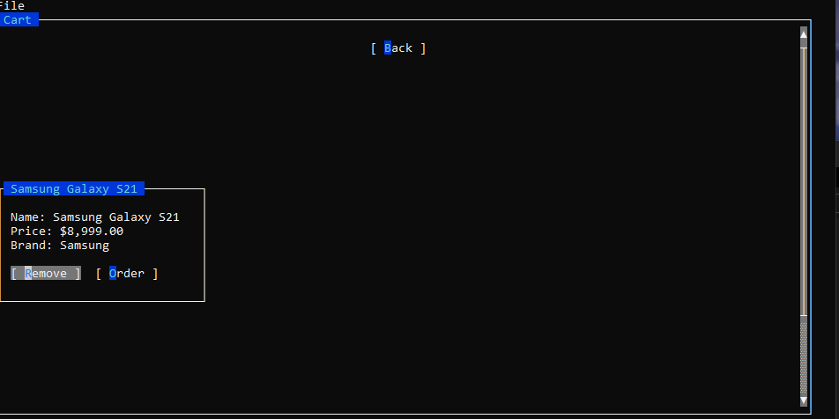
UI Design

Slide 48
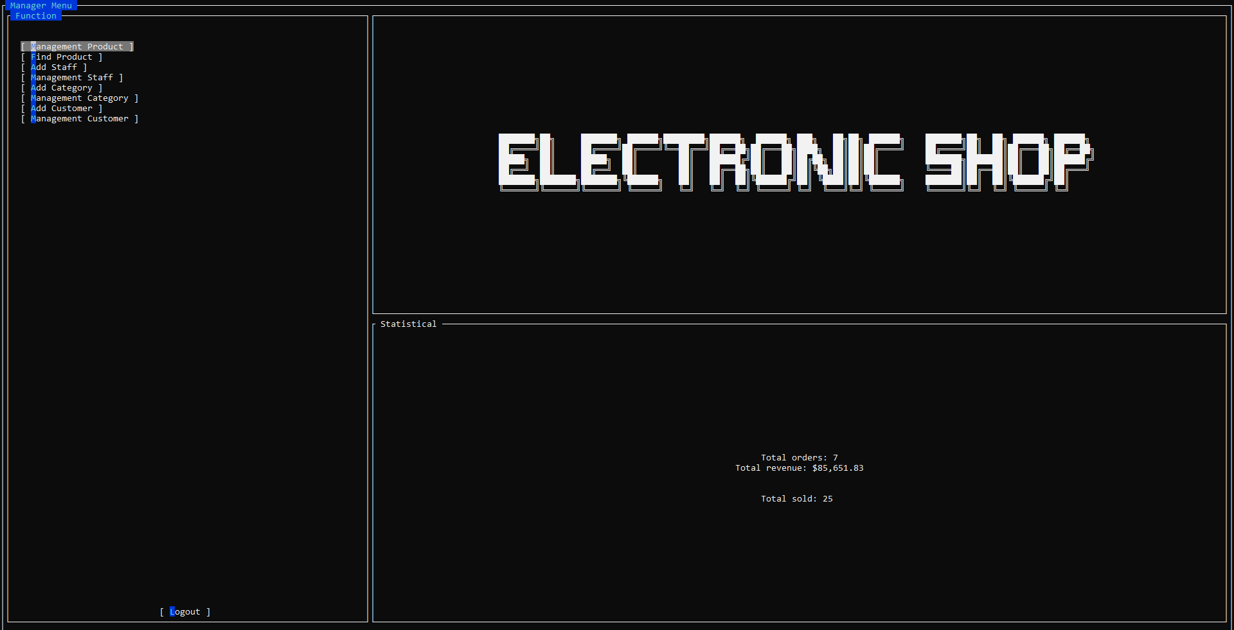
UI Design

Slide 49
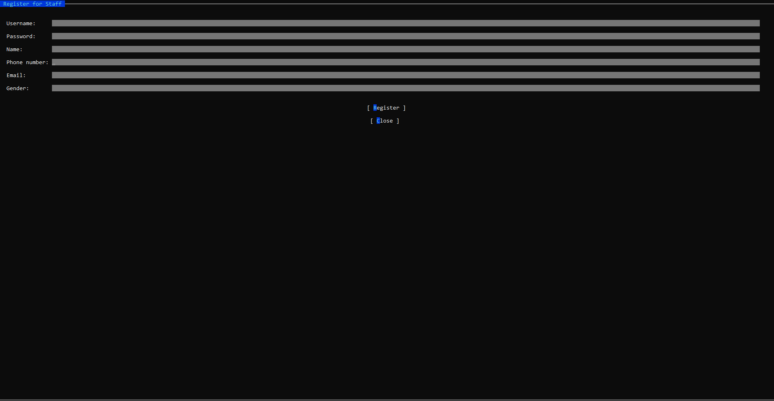
UI Design

Slide 50
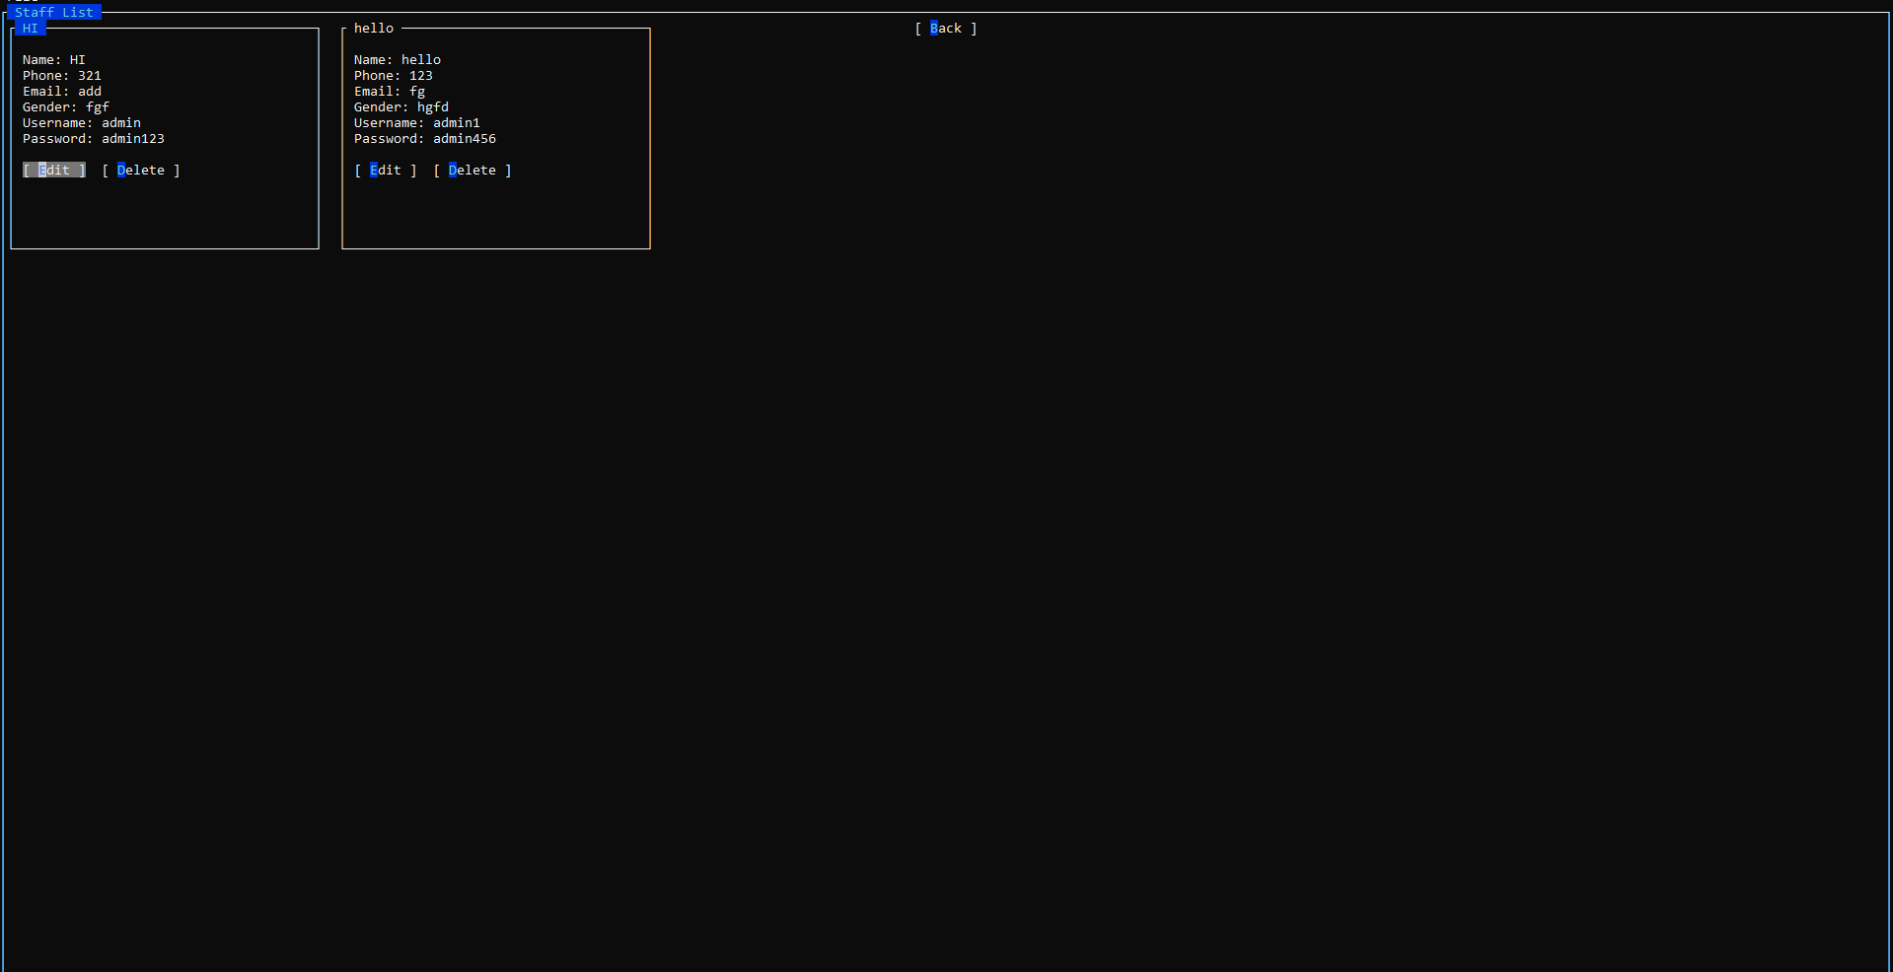
UI Design

Slide 51
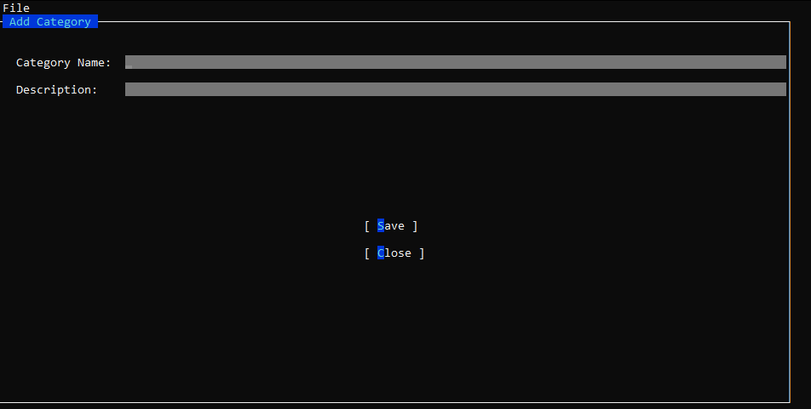
UI Design

Slide 52
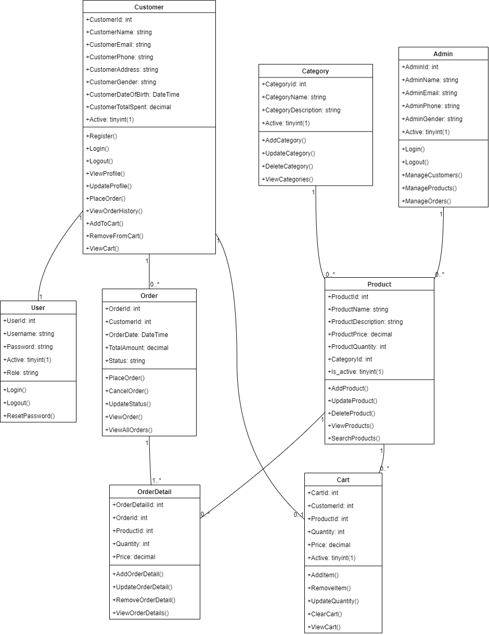
Class Diagram

Slide 53
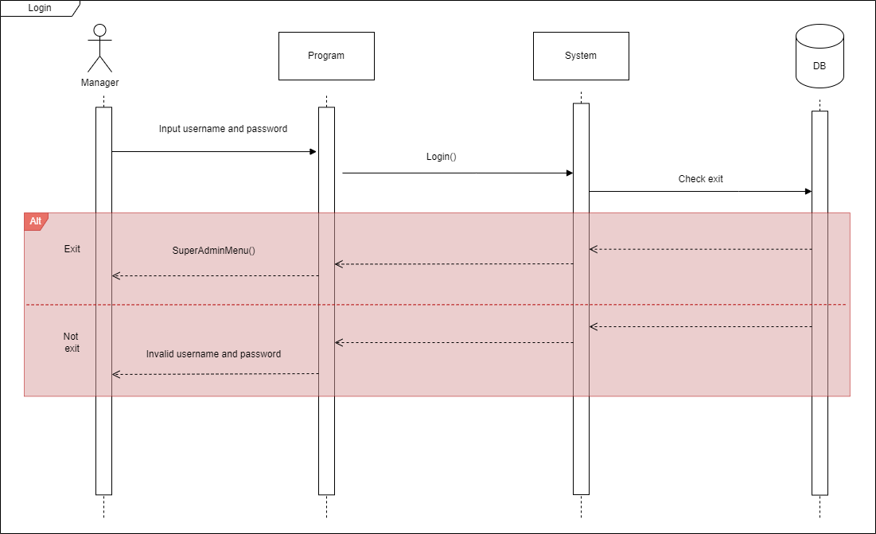
Sequence Diagram

Slide 54
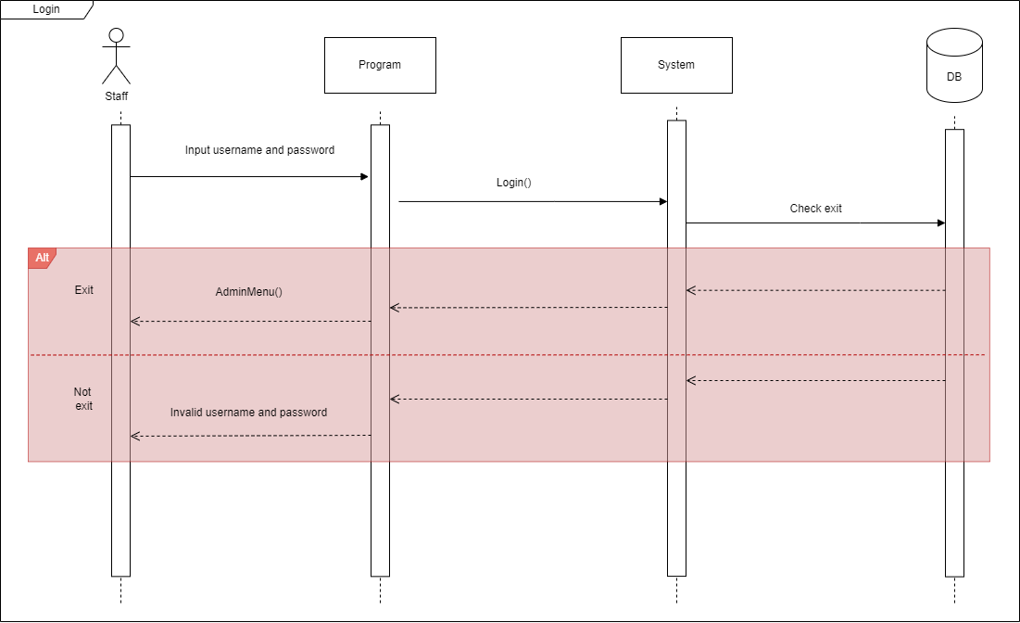
Sequence Diagram

Slide 55
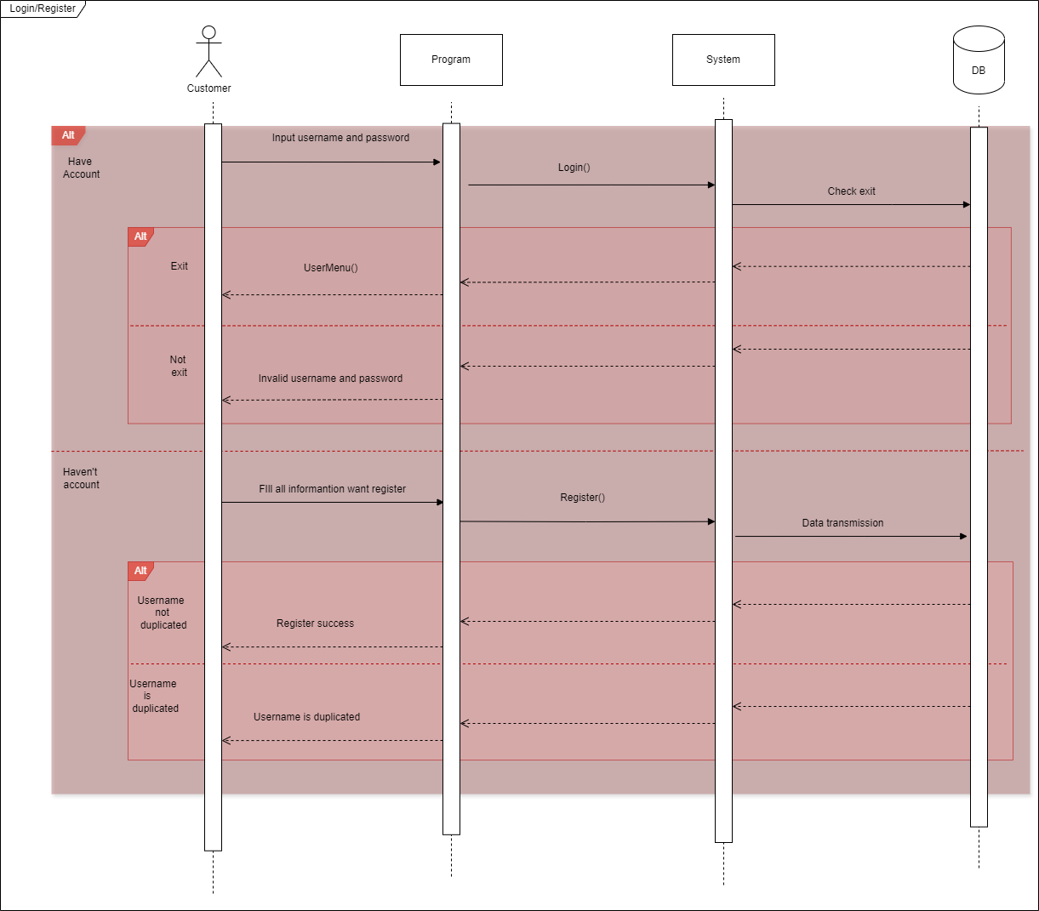
Sequence Diagram

Slide 56
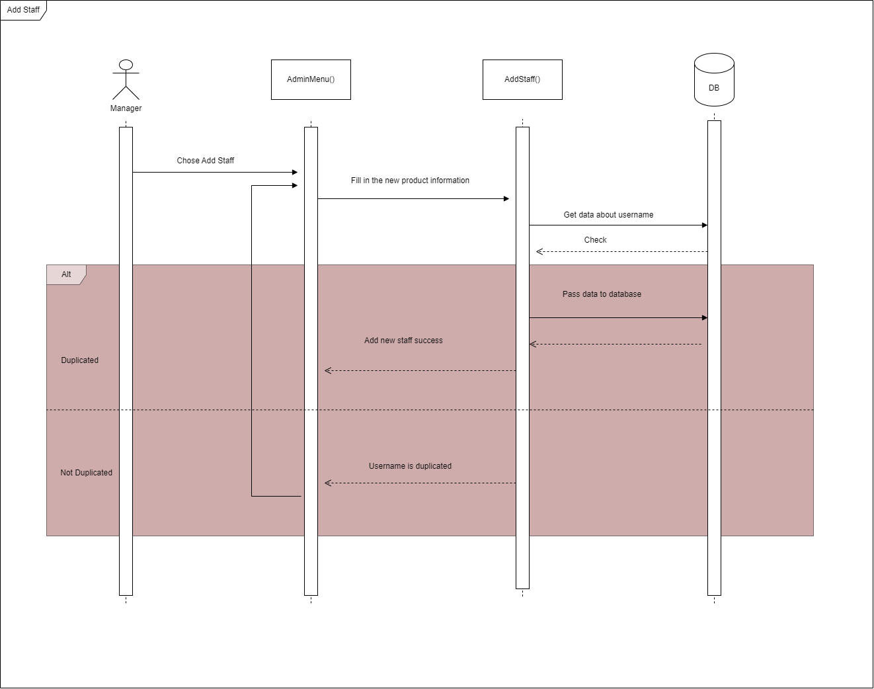
Sequence Diagram

Slide 57
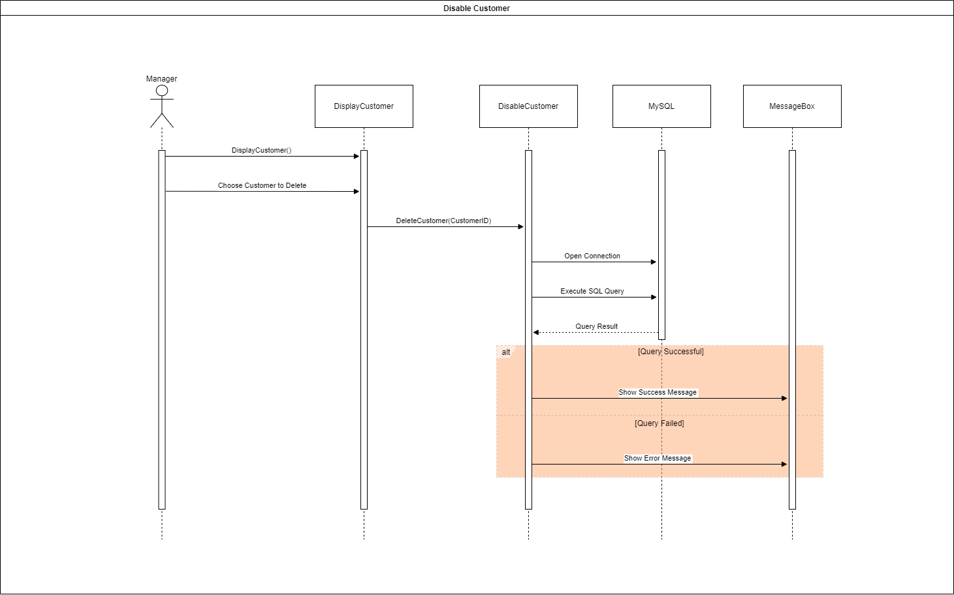
Sequence Diagram

Slide 58
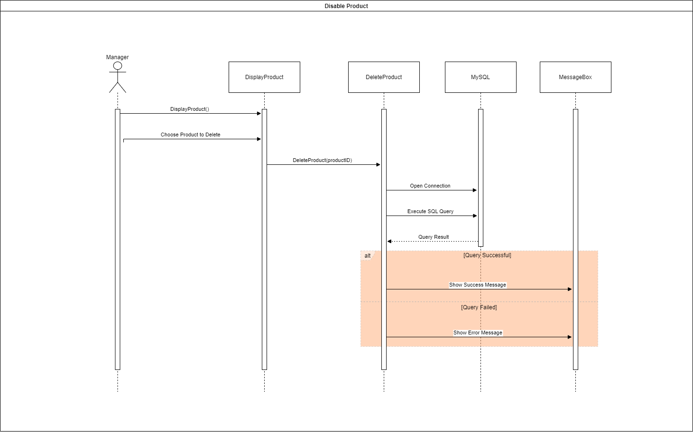
Sequence Diagram

Slide 59

Sequence Diagram

Slide 60

Sequence Diagram

Slide 61

Sequence Diagram

Slide 62

Sequence Diagram

Slide 63

Sequence Diagram

Slide 64

Sequence Diagram

Slide 65

Sequence Diagram

Slide 66

Sequence Diagram

Slide 67

Sequence Diagram

Slide 68

Sequence Diagram

Slide 69

Sequence Diagram

Slide 70

Sequence Diagram

Slide 71

Sequence Diagram

Slide 72

Sequence Diagram

Slide 73

Sequence Diagram

Slide 74

Sequence Diagram

Slide 75

Sequence Diagram

Slide 76

Sequence Diagram

Slide 77

Sequence Diagram

Slide 78

Sequence Diagram

Slide 79

Sequence Diagram

Slide 80

Sequence Diagram

Slide 81

Sequence Diagram

Slide 82

Sequence Diagram

Slide 83

Sequence Diagram

Slide 84

Sequence Diagram

Slide 85

Sequence Diagram

Slide 86

Entity Relationship Diagram

Slide 87

Deployment Diagram

Slide 88
Task Assign (to each team member)
HCL | HCL Electronic Shop
No | Task name | Description | Start Date | End Date | Member | Self Assessment
1 | Create Database | Create and make changes or adjustments to the database. | May 29th | June 1st | Long, Cuong & Huy
2 | Code Logic | Come up with most of the ideas for how the system of the application will work. | May 29th | June 10th | Long & Huy
3 | Draw Diagram | Drawing flowcharts and the diagrams for the code logic. | May 29th | June 15th | Long & Huy
4 | Code | Writing the program. | May 29th | June 27th | Long, Cuong & Huy
5 | Write Report | Make the detailed report about the project progression and explain all the functions. | June 28th |  | Long, Cuong & Huy
6 | Make Slides | Make power point slides of the report for presentation. | June 28th |  | Cuong & Huy

Slide 89
Experience Learned
Through working on the project to make the HCL digital marketing console application, we have learnt a lot of things.
  We get to learn how to work as a team of developer, improved ourselves through our experiences and learnt a lot from each others.
  We get to experienced how an actual program developing progress would actually go, and what we need or have to do to prepare ourselves to work in such environment.
  Through difficulties we also learnt our own flaws and improved ourselves by fixing each other’s mistakes.
  We gained more experienced on using these development tools, which come of great help while we were working on the project.
  We’re still improving our skills on using MySQL or C# which this project provided us with a lot of practicing opportunity and we get to try a lot of things that we’ve have never gotten to try before hand.

Slide 90


Slide 91
Q & A

